Slide 1

Chapter 4
Frames and Errors
Jill West | Curt M. White, Data Communications and Computer Networks: A Business User’s Approach, 9th Edition. © 2023 Cengage. All Rights Reserved. May not be scanned, copied or duplicated, or posted to a publicly accessible website, in whole or in part.

Slide 2
After reading this chapter, you should be able to:
Explain the components of data link layer frames
Identify types of network noise that cause transmission errors
Describe the strengths and limitations of various error detection techniques
Compare error control techniques and appropriate uses of each type

Slide 3
Introduction
Interface standards define the physical connection between devices, a.k.a., data link connections
Data link connections are defined through the specification of Data Link Frames
Every time a data link frame is transmitted, errors can occur (frequently due to noise)
Communication systems should perform checks to detect transmission errors
Once an error is detected, a system may perform some form of error control

Slide 4
Data Link Responsibilities
A data link frame is like an "envelope" for the transmitted data
Given the protocol, the data link frame has to inform
which device the message is intended for
what is the basic form of the data frame
when the data can/will be sent along the medium to avoid overlapping signals interfering with each other
information to be able to detect/correct errors
Protocols are provided within the TCP/IP protocol suite

Slide 5
Frame Components (1 of 6)
A frame contains:
the data to be transmitted, called payload
extra bits are added as
synchronization bits
headers for each TCP/IP layer (including addresses, error detection/control)
optional trailers for each TCP/IP layer

Slide 6
Frame Components (2 of 6)
The TCP/IP layers covered are:
The transport layer contains the port number that identifies which application on the receiving device
The network layer contains the IP address that identifies the destination computer uniquely across multiple networks
The data link layer contains the MAC (media access control) address that identifies each device’s network port uniquely on its local network

Slide 7
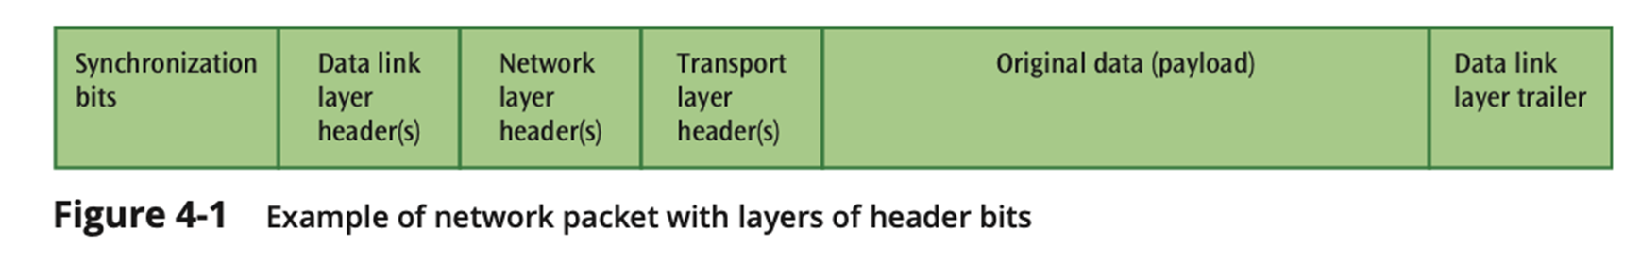
Frame Components (3 of 6)

Slide 8
Frame Components (4 of 6)
A packet sniffer, like Wireshark, can can capture packets as they traverse a network
The analysis of the bits' package shows which protocol is adding header bits and where these headers are located
The transport layer follows the TCP (Transport Control Protocol)
Port address
The Network layer follows the IP (Internet Protocol)
IP address
The Data Link layer follows the Ethernet protocol
MAC address

Slide 9
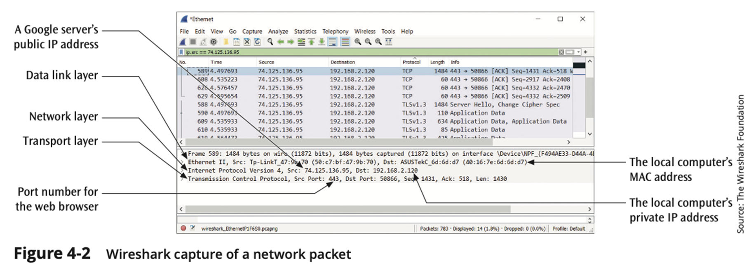
Frame Components (5 of 6)

Slide 10
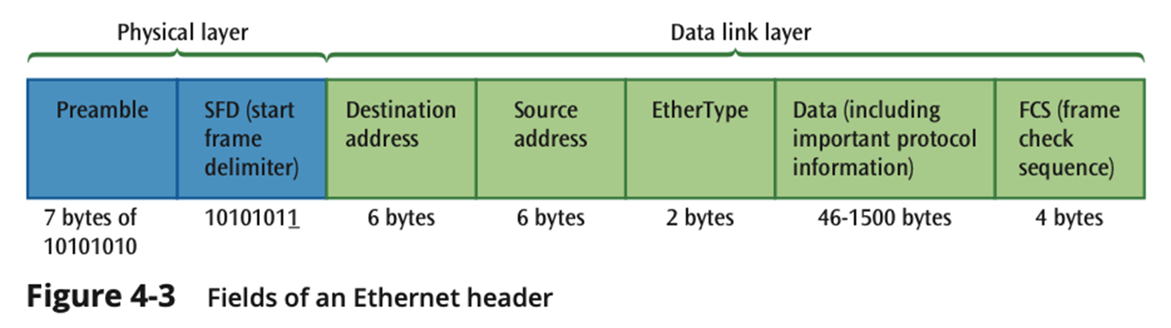
Frame Components (6 of 6)

Slide 11
Noise and Errors (1 of 2)
Noise is unavoidable, something will invariably alter the form of the original data
More harmful in high transmission speed
Kinds of noise and errors:
Gaussian (white) noise
Impulse noise
Crosstalk
Echo
Jitter
Attenuation
Error prevention

Slide 12
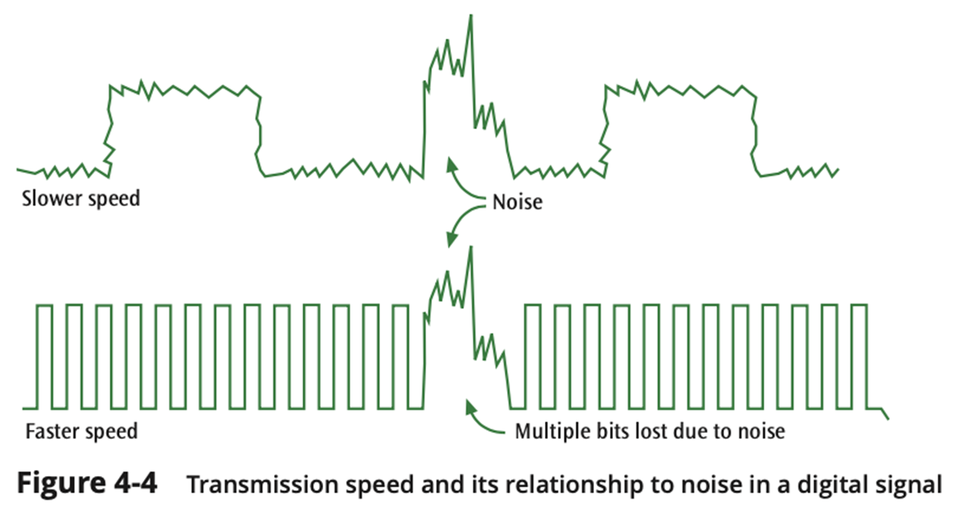
Noise and Errors (2 of 2)

Slide 13
Gaussian Noise (1 of 2)
Also known as thermal or white noise
Relatively constant and can be reduced
It affects transmission speed
If white noise gets too strong, it can completely disrupt the signal

Slide 14
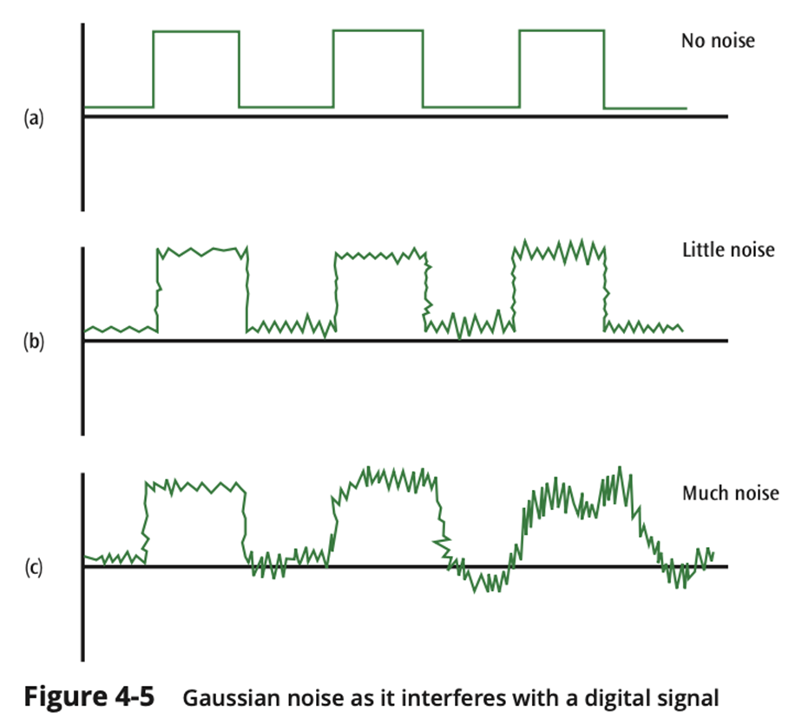
White Noise (2 of 2)

Slide 15
Impulse Noise (1 of 2)
Also known as noise spike
One of the most disruptive forms of noise
Random spikes of power that can destroy one or more bits of information
Difficult to remove from an analog signal because it may be hard to distinguish from the original signal
Impulse noise can damage more bits if the bits are closer together (transmitted at a faster rate)

Slide 16
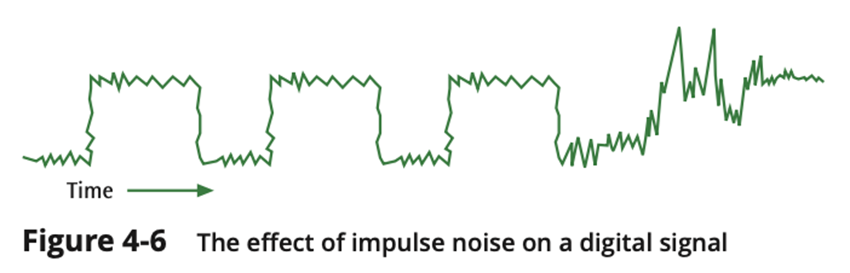
Impulse Noise (2 of 2)

Slide 17
Crosstalk (1 of 2)
Unwanted coupling between two different signal paths
For example, hearing another conversation while talking on the telephone
Relatively constant and can be reduced with proper measures

Slide 18
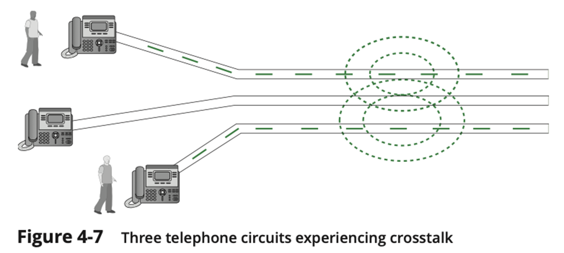
Crosstalk (2 of 2)

Slide 19
Echo (1 of 2)
The reflective feedback of a transmitted signal as the signal moves through a medium
Most often occurs on coaxial cable
If echo bad enough, it could interfere with original signal
Relatively constant, and can be significantly reduced

Slide 20
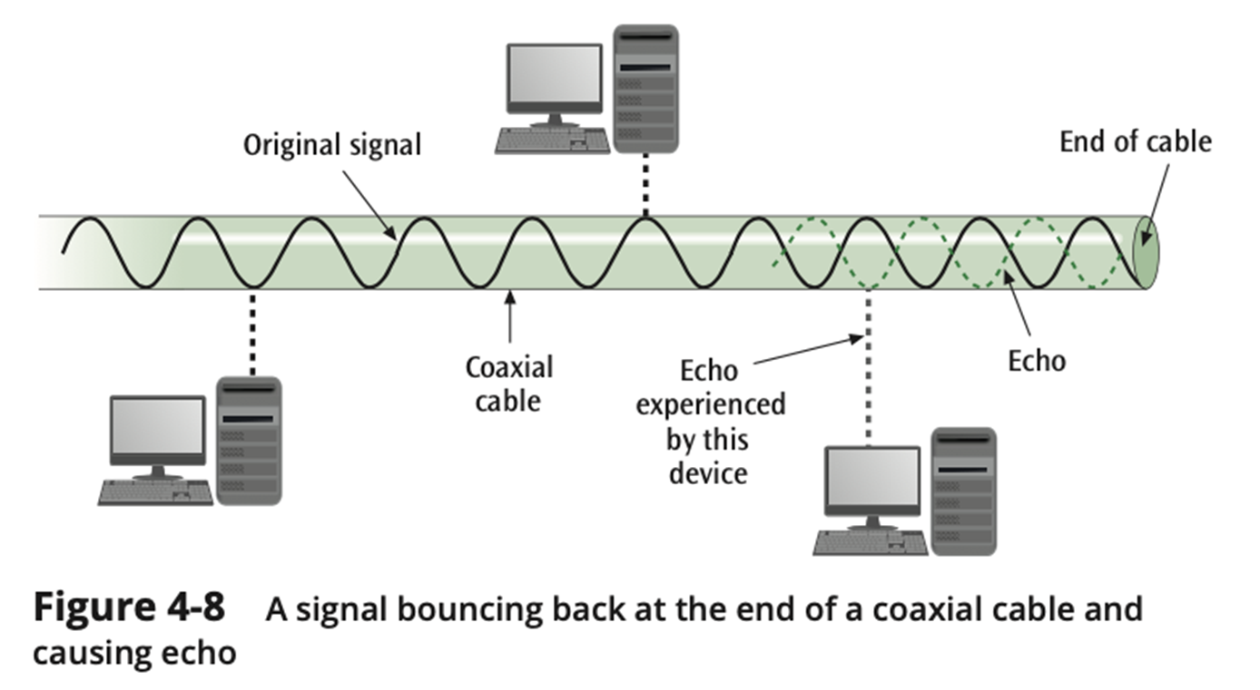
Echo (2 of 2)

Slide 21
Jitter (1 of 2)
The result of small timing irregularities during the transmission of digital signals
Occurs when a digital signal is repeated over and over
If serious enough, jitter forces systems to slow down their transmission
Steps can be taken to reduce jitter

Slide 22
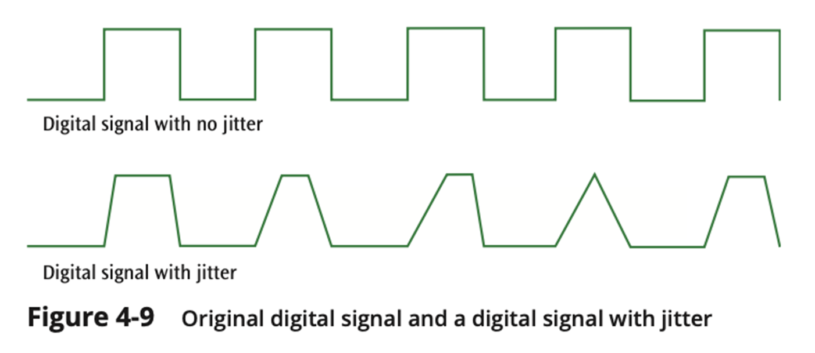
Jitter (2 of 2)

Slide 23
Attenuation
The continuous loss of a signal’s strength as it travels through a medium
It can be remediated by the use of:
amplifiers for analog systems
repeaters for digital systems

Slide 24
Error Prevention (1 of 2)
To prevent errors from happening, several techniques may be applied:
Proper shielding of cables to reduce interference
Telephone line conditioning or equalization
Replacing older media and equipment with new, possibly digital components
Proper use of digital repeaters and analog amplifiers
Observe the stated capacities of the media

Slide 25
Error Prevention (2 of 2)
Table 4-1 Summary of Errors and Error-Prevention Techniques
Type of Error | Error Prevention Technique
Gaussian noise | Install special filters for analog signals; implement digital signal regeneration for digital signals
Impulse noise | Install special filters for analog signals; implement digital signal processing for digital signals
Crosstalk | Install proper shielding on cables
Echo | Install proper termination on cables
Jitter | Use better-quality electronic circuitry; use fewer repeaters; slow the transmission speed
Attenuation* | Install device that amplifies analog signals; implement digital signal regeneration of digital signals
*Not a type of error, but indirectly affects error rates

Slide 26
Error Detection
Despite the best prevention techniques, errors may still happen
To detect an error, something extra has to be added to the data/signal
This extra is an error detection code
Three basic techniques for detecting errors:
parity checking
arithmetic checksum
cyclic redundancy checksum

Slide 27
Parity Checks (1 of 6)
Simple parity
If performing even parity, add a parity bit such that an even number of 1s are maintained
If performing odd parity, add a parity bit such that an odd number of 1s are maintained
For example, send 1001010 using even parity
For example, send 1001011 using even parity

Slide 28
Parity Checks (2 of 6)
Simple parity (continued)
What happens if the character 10010101 is sent and the first two 0s accidentally become two 1s?
Thus, the following character is received: 11110101
Will there be a parity error?
Problem: Simple parity only detects odd numbers of bits in error

Slide 29
Parity Checks (3 of 6)
Longitudinal parity
Adds a parity bit to each character then adds a row of parity bits after a block of characters
The row of parity bits is actually a parity bit for each “column” of characters
The row of parity bits plus the column parity bits add a great amount of redundancy to a block of characters

Slide 30
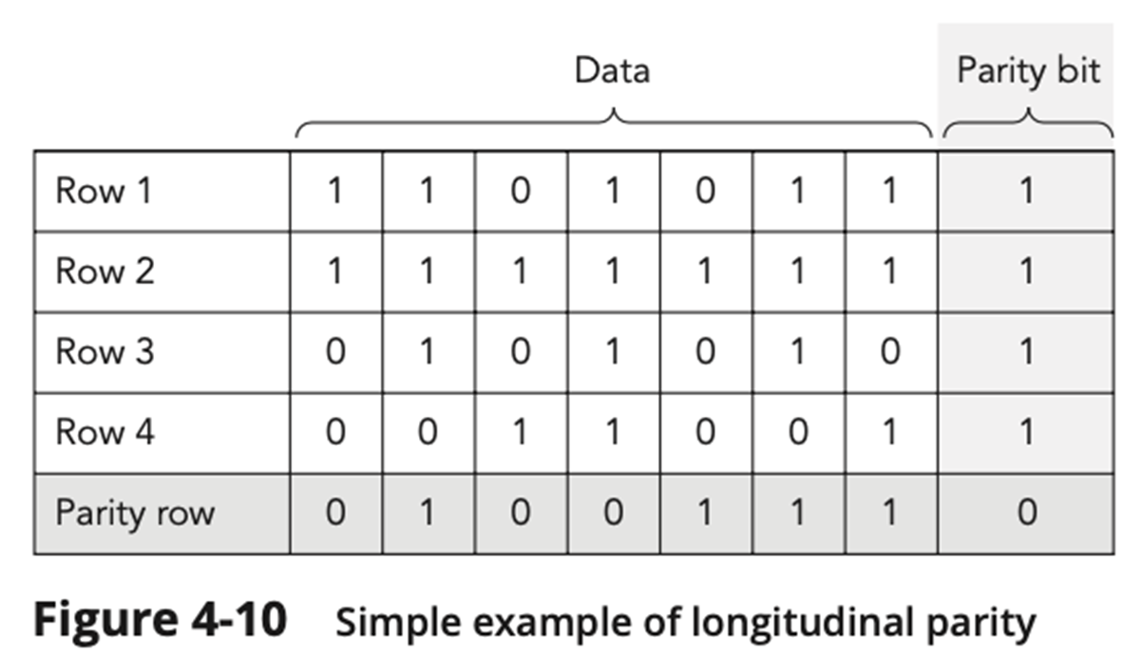
Parity Checks (4 of 6)

Slide 31
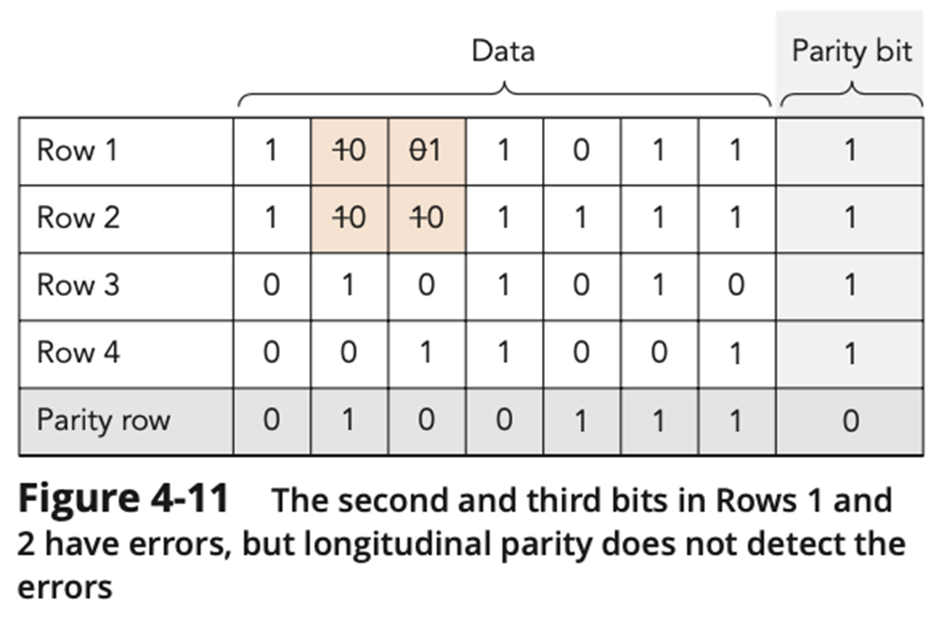
Parity Checks (5 of 6)

Slide 32
Parity Checks (6 of 6)
Both simple parity and longitudinal parity do not catch all errors
Simple parity only catches odd numbers of bit errors
Longitudinal parity is better at catching errors but requires too many check bits added to a block of data
We need a better error detection method
What about arithmetic checksum?

Slide 33
Arithmetic Checksum (1 of 3)
Used in TCP and IP on the Internet
Characters to be transmitted are converted to numeric form and summed
Sum is placed in some form at the end of the transmission

Slide 34
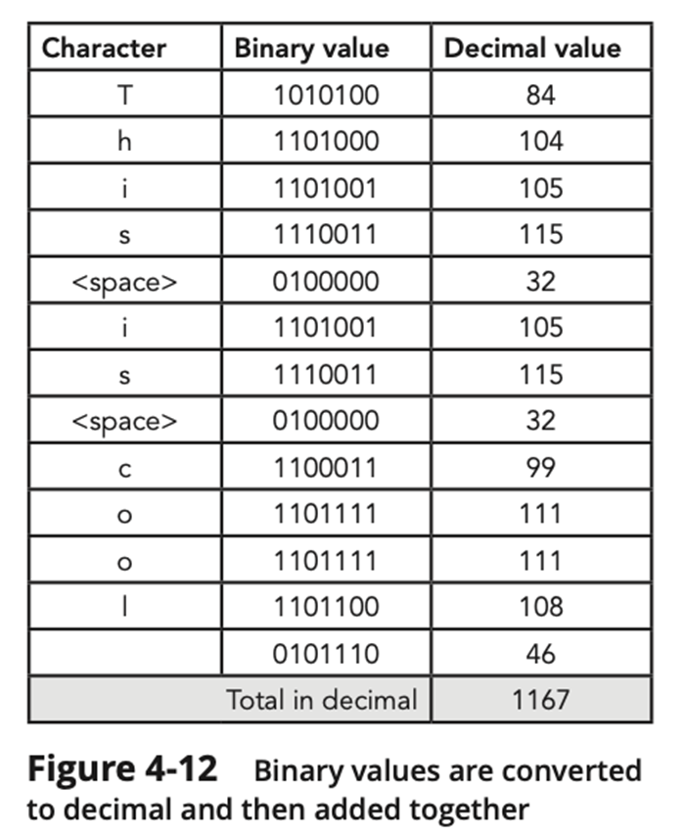
Arithmetic Checksum (2 of 3)
For example, the message "This is cool."
The value 1167 is added at the end of the message

Slide 35
Arithmetic Checksum (3 of 3)
Receiver performs same conversion and summing and compares new sum with sent sum
TCP and IP processes a little more complex but idea is the same
But even arithmetic checksum can let errors slip through
Is there something more powerful yet?

Slide 36
Cyclic Redundancy Checksum (1 of 4)
CRC error detection method treats the packet of data to be transmitted as a large polynomial
Transmitter takes the message polynomial and using polynomial arithmetic, divides it by a given generating polynomial
Quotient is discarded but the remainder is “attached” to the end of the message

Slide 37
Cyclic Redundancy Checksum (2 of 4)
The message (with the remainder) is transmitted to the receiver
The receiver divides the message and remainder by the same generating polynomial
If a remainder not equal to zero results, there was an error during transmission
If a remainder of zero results, there was no error during transmission

Slide 38
Cyclic Redundancy Checksum (3 of 4)
Table 4-2 Generator polynomials for common CRC methods
CRC Method | Generator Polynomial | Normal Representation | Common Use
CRC-8 | x⁸ + x⁷ + x⁶ + x⁴ + x² + 1 | OxD5 | Digital satellite TV
CRC-12 | x¹² + x¹¹ + x³ + x² + x + 1 | Ox8OF | Telecom
CRC-16 | x¹⁶ + x¹⁵ + x² + 1 | 0x8005 | USB
CRC-CCITT (also known as CRC-16-CCITT) | x¹⁶ + x¹² + x⁵ + 1 | Ox1021 | Bluetooth
CRC-32 | x³² + X²⁶ + X²³ + x²² + X¹⁶ + X¹² + x¹¹ + x¹⁰ + x⁸ + x⁷ + x⁵ + x⁴ + x² + x + 1 | Ox04C11DB7 | Ethernet

Slide 39
Cyclic Redundancy Checksum (4 of 4)
Table 4-3 Error-detection performance of CRC
Type of Error | Error-Detection Performance
Single-bit errors | 100 percent
Double-bit errors | 100 percent if the generating polynomial has at least three 1s (they all do)
Odd number of bits in error | 100 percent if the generating polynomial contains a factor x + 1 (they all do)
An error burst of length < r + 1 | 100 percent
An error burst of length = r + 1 | Probability = 1 − (1/2)^{(r−1)} (very near 100%)
An error burst of length > r + 1 | Probability = 1 − (1 /2)^{r} (very near 100%)

Slide 40
Error Control
Once an error is detected, what is the receiver going to do?
Do nothing (simply toss the frame or packet)
Return an error message to the transmitter
Fix the error with no further help from the transmitter

Slide 41
Toss the Frame/Packet (do nothing)
Seems like a strange way to control errors but some lower-layer protocols such as frame relay perform this type of error control
For example, if frame relay detects an error, it simply tosses the frame
No message is returned
Frame relay assumes a higher protocol (such as TCP/IP) will detect the tossed frame and ask for retransmission

Slide 42
Return the Message
Once an error is detected, an error message is returned to the transmitter
Two basic forms:
Stop-and-wait error control
Sliding window error control

Slide 43
Stop-and-Wait Error Control (1 of 2)
Stop-and-wait is the simplest of the error control protocols
A transmitter sends a frame then stops and waits for an acknowledgment
If a positive acknowledgment (ACK) is received, the next frame is sent
If a negative acknowledgment (NAK) is received, the same frame is transmitted again

Slide 44
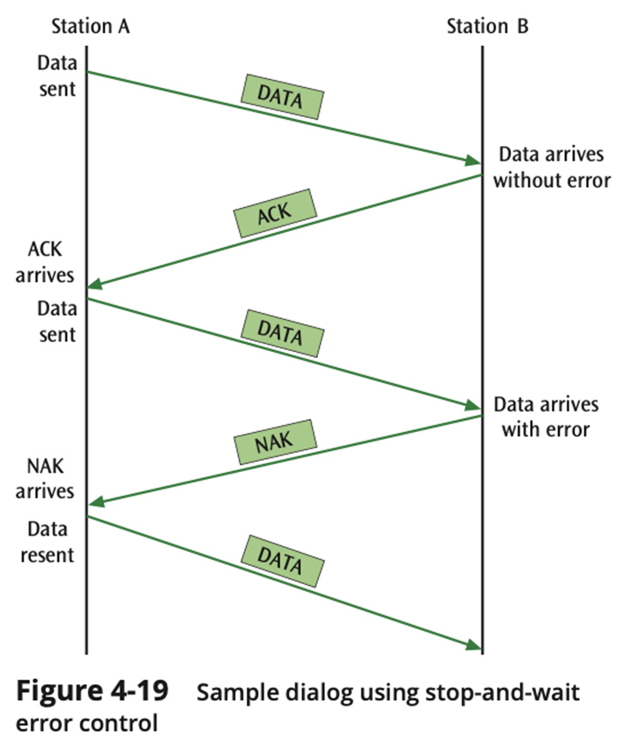
Stop-and-Wait Error Control (2 of 2)

Slide 45
Sliding Window Error Control (1 of 12)
These techniques assume that multiple frames are in transmission at one time
A sliding window protocol allows the transmitter to send a number of data packets at one time before receiving any acknowledgments
Depends on window size
When a receiver does acknowledge receipt, the returned ACK contains the number of the frame expected next

Slide 46
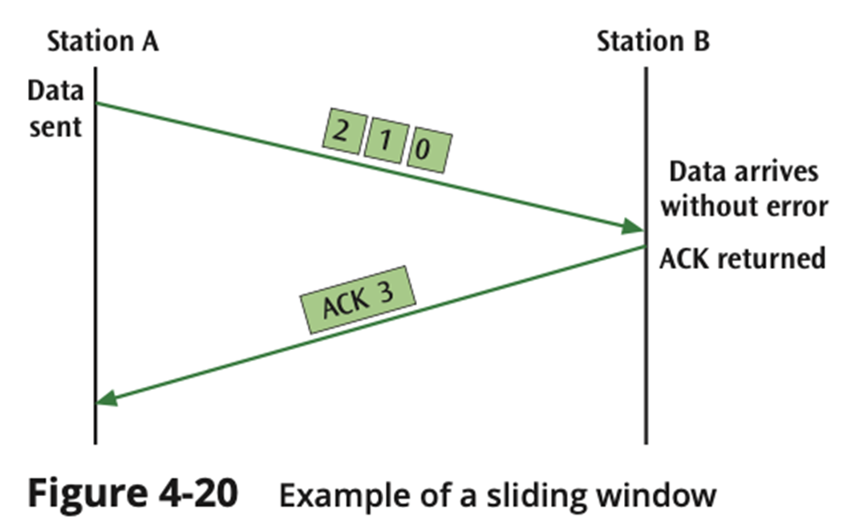
Sliding Window Error Control (2 of 12)

Slide 47
Sliding Window Error Control (3 of 12)
Older sliding window protocols numbered each frame or packet that was transmitted
More modern sliding window protocols number each byte within a frame
An example in which the packets are numbered, followed by an example in which the bytes are numbered:

Slide 48
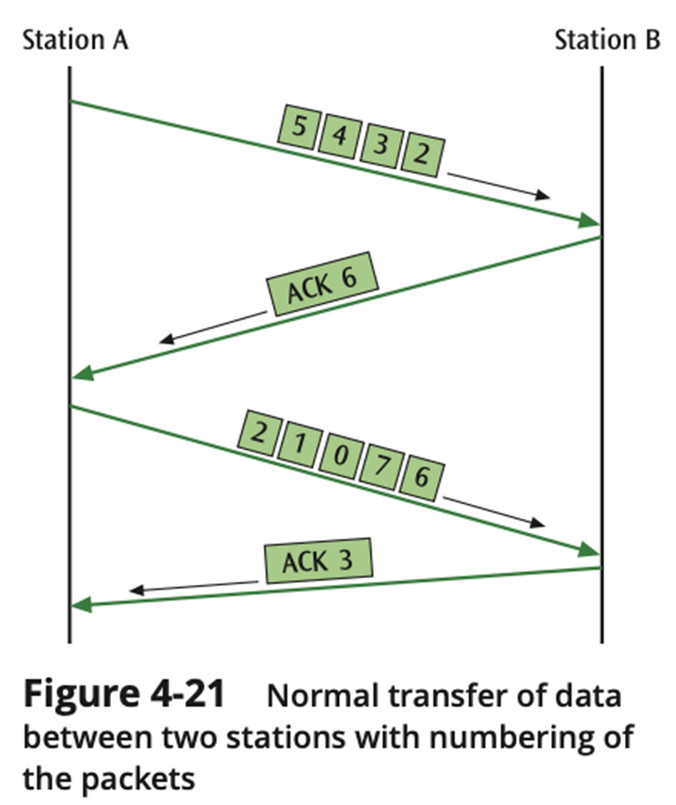
Sliding Window Error Control (4 of 12)

Slide 49
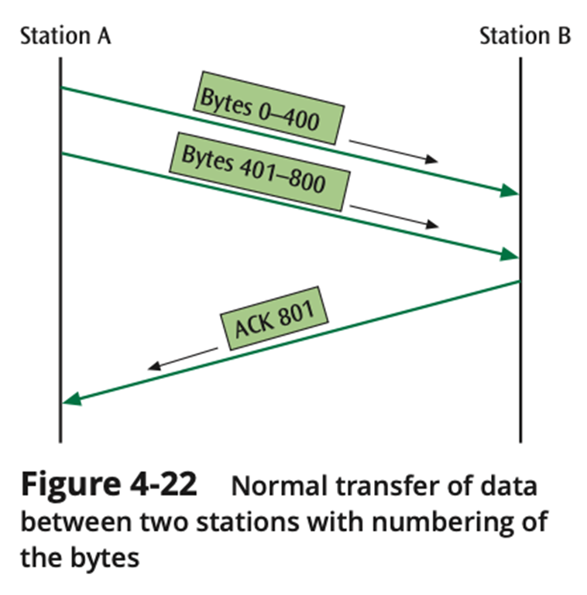
Sliding Window Error Control (5 of 12)

Slide 50
Sliding Window Error Control (6 of 12)
Notice that an ACK is not always sent after each frame is received
It is more efficient to wait for a few received frames before returning an ACK
How long should you wait until you return an ACK?

Slide 51
Sliding Window Error Control (7 of 12)
Using TCP/IP, there are some basic rules concerning ACKs:
Rule 1: If a receiver just received data and wants to send its own data, piggyback an ACK along with that data
Rule 2: If a receiver has no data to return and has just ACKed the last packet, receiver waits 500 ms for another packet
If while waiting, another packet arrives, send the ACK immediately
Rule 3: If a receiver has no data to return and has just ACKed the last packet, receiver waits 500 ms
No packet, send ACK

Slide 52
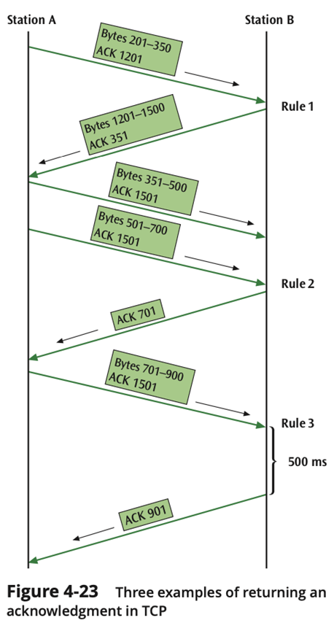
Sliding Window Error Control (8 of 12)

Slide 53
Sliding Window Error Control (9 of 12)
What happens when a packet is lost?
As shown in the next slide, if a frame is lost, the following frame will be “out of sequence”
The receiver will hold the out of sequence bytes in a buffer and request the sender to retransmit the missing frame

Slide 54
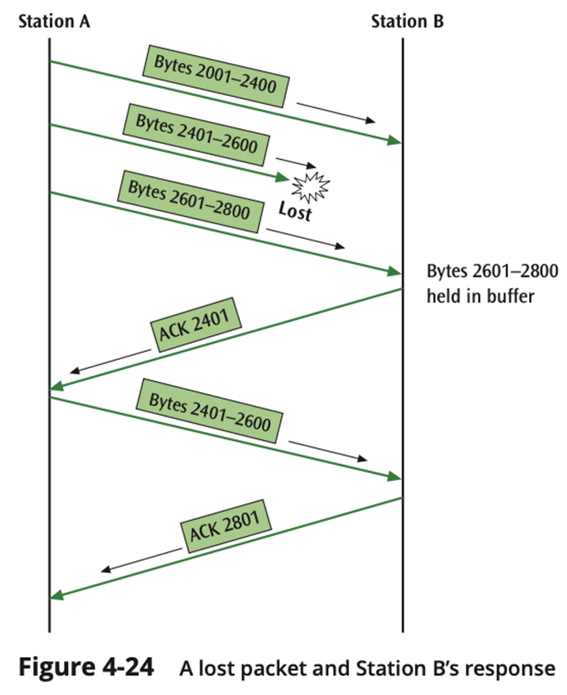
Sliding Window Error Control (10 of 12)

Slide 55
Sliding Window Error Control (11 of 12)
What happens when an ACK is lost?
As shown in the next slide, if an ACK is lost, the sender will wait for the ACK to arrive and eventually time out
When the time-out occurs, the sender will resend the last frame

Slide 56
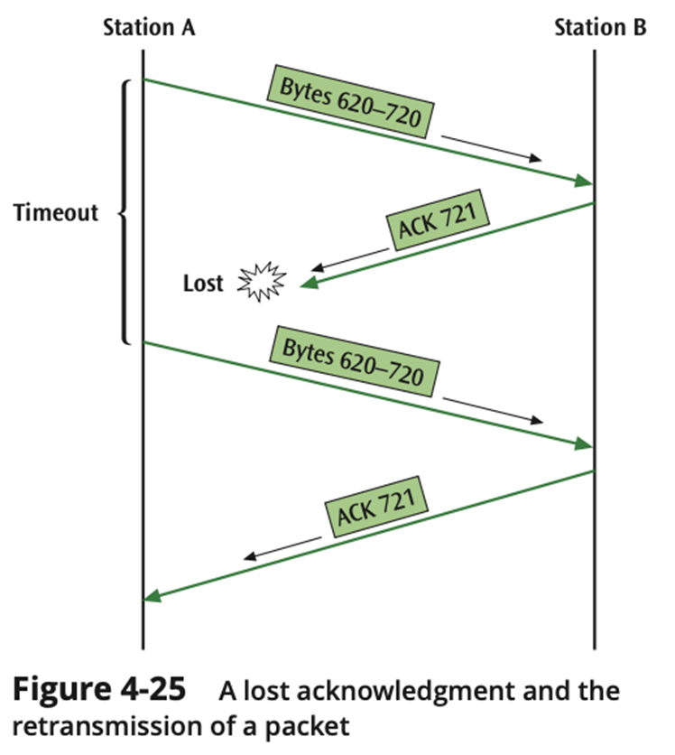
Sliding Window Error Control (12 of 12)

Slide 57
Correct the Error (1 of 7)
For a receiver to correct the error with no further help from the transmitter requires a large amount of redundant information to accompany the original data
This redundant information allows the receiver to determine the error and make corrections
This type of error control is often called forward error correction and involves codes called Hamming codes

Slide 58
Correct the Error (2 of 7)
Hamming codes add additional check bits to a character
These check bits perform parity checks on various bits
Example: One could create a Hamming code in which 4 check bits are added to an 8-bit character
We can number the check bits c8, c4, c2 and c1
We will number the data bits b12, b11, b10, b9, b7, b6, b5, and b3
Place the bits in the following order: b12, b11, b10, b9, c8, b7, b6, b5, c4, b3, c2, c1

Slide 59
Correct the Error (3 of 7)
Example (continued):
c8 will perform a parity check on bits b12, b11, b10, and b9
c4 will perform a parity check on bits b12, b7, b6, and b5
c2 will perform a parity check on bits b11, b10, b7, b6, and b3
c1 will perform a parity check on bits b11, b9, b7, b5, and b3
The next slide shows the check bits and their values

Slide 60
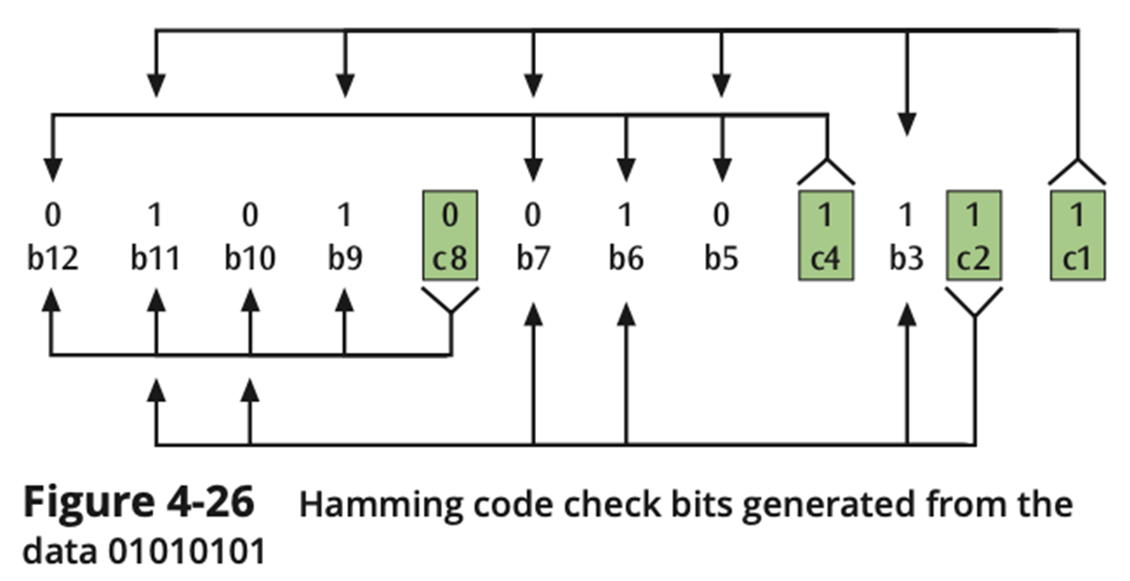
Correct the Error (4 of 7)

Slide 61
Correct the Error (5 of 7)
The sender will take the 8-bit character and generate the 4 check bits as described
The 4 check bits are then added to the 8 data bits in the sequence as shown and then transmitted
The receiver will perform the 4 parity checks using the 4 check bits
If no bits flipped during transmission, then there should be no parity errors
What happens if one of the bits flipped during transmission?

Slide 62
Correct the Error (6 of 7)
For example, what if bit b9 flips?
The c8 check bit checks bits b12, b11, b10, b9 and c8 (01000)
This would cause a parity error
The c4 check bit checks bits b12, b7, b6, b5, and c4 (00101)
This would not cause a parity error (even number of 1s)
The c2 check bit checks bits b11, b10, b7, b6, b3, and c2 (100111)
This would not cause a parity error

Slide 63
Correct the Error (7 of 7)
For example, what if bit b9 flips? (continued)
The c1 check bit checks b11, b9, b7, b5, b3, and c1 (100011)
This would cause a parity error
Writing the parity errors in sequence gives us 1001, which is binary for the value 9
Thus, the bit error occurred in the 9th position

Slide 64
Summary (1 of 4)
The two functions of the data link layer are:
to create a frame of data for transmission between sender and receiver
to provide some way of checking for errors during transmission
A data link layer frame consists of a header and a trailer surrounding the payload
The fields of each header vary depending on the protocol that creates the header
The trailer is almost always some form of error detection and correction information

Slide 65
Summary (2 of 4)
Noise is always present in computer networks, and if the noise level is too high, errors will be introduced during the transmission of data
Types of noise include white noise, impulse noise, crosstalk, echo, jitter, and attenuation
Among the techniques for reducing noise are proper shielding of cables, telephone line conditioning or equalization, using modern digital equipment, using digital repeaters and analog amplifiers, and observing the stated capacities of media

Slide 66
Summary (3 of 4)
Three basic forms of error detection are parity, arithmetic checksum, and cyclic redundancy checksum
Cyclic redundancy checksum is a superior error-detection scheme with almost 100 percent capability of recognizing corrupted data packets
Once an error has been detected, there are three possible options: do nothing, return an error message, and correct the error

Slide 67
Summary (4 of 4)
Stop-and-wait protocol allows only one packet to be sent at a time
Sliding window protocol allows multiple packets to be sent at one time
Error correction is a possibility if the transmitted data contains enough redundant information so that the receiver can properly correct the error without asking the transmitter for additional information

